Slide 1
Thesis Meeting
Josyula Viswanath Das
Emilio Benenati

Slide 2
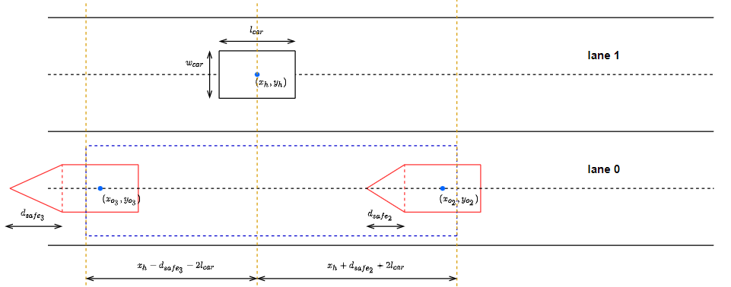

Slide 3
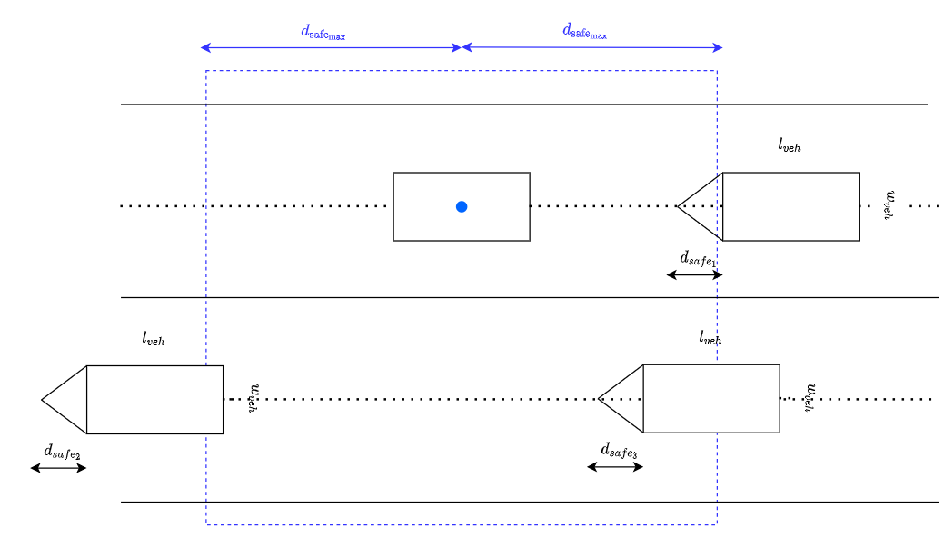

Slide 4
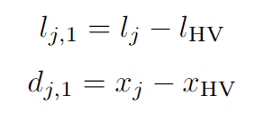



Let us define
where and are the lane and the longitudinal position of the jth obstacle and and are the lane and the longitudinal position of the host vehicle.
Defined as the maximum safe distance if the obstacle vehicle is travelling at the maximum allowed velocity.

Slide 5

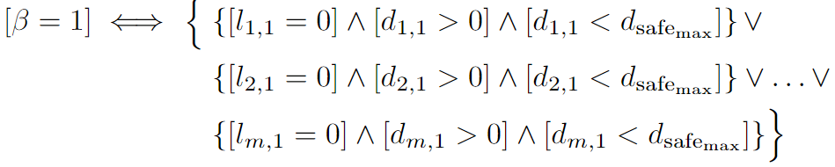
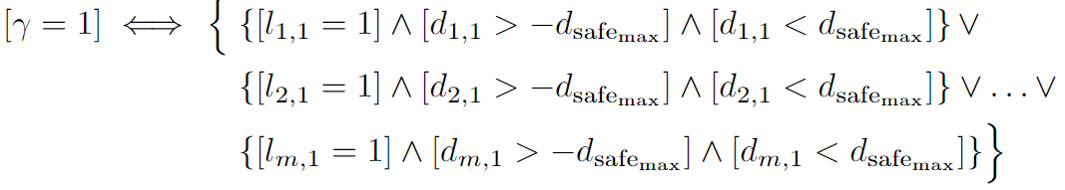
Assuming that there is no vehicle in the same lane as that of the host vehicle ( )
Assuming that there is a vehicle in the same lane as that of the host vehicle and that the longitudinal distance between the host vehicle and the obstacle is less than
Assuming that there is a vehicle within the safe region (as shown in blue in the image)

Slide 6
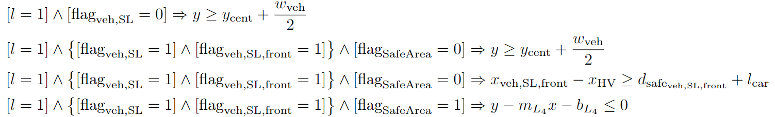
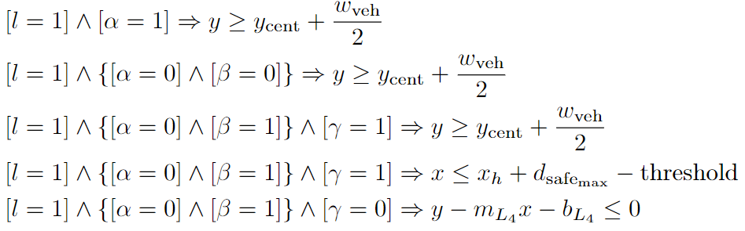
Equations during the last meeting
New equations

Slide 7
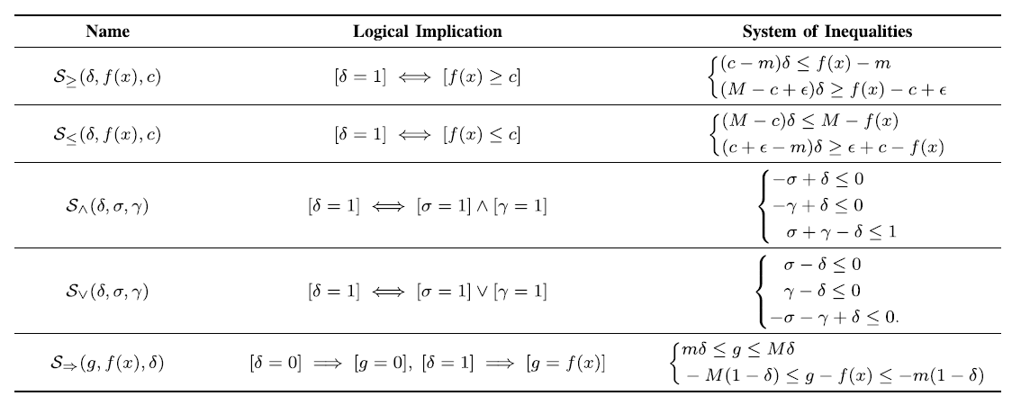

Slide 8
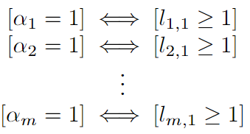
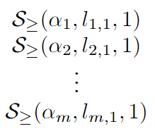
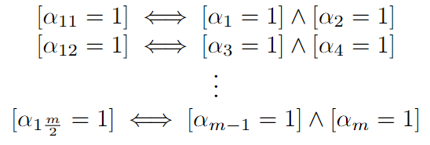
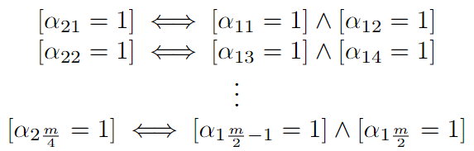
Let is take and rewrite
Assume
Using the table in the last slide, this can be rewritten as
Now to see that if m is even, we make pairs and then

Slide 9

Do the pairing till we have only two left and then combine them.
If m is even, then leave out of the pairing and then continue till we have only one and then join them.

